Slide 1
Hidden Markov Model
Il-Chul Moon Dept. of Industrial and Systems Engineering KAIST
icmoon@kaist.ac.kr

Slide 2

Weekly Objectives
Learn hidden Markov model
Transition from the static clustering to the dynamic clustering
Understand the difference of the graphical model
Know and able to answer the three major questions of HMM
Know how to solve the evaluation question
Know how to solve the decoding question
Know how to solve the learning question
Link to the previous lectures
Link the forward-backward algorithm to the message passing
Link the baum-welch algorithm to the EM algorithm

Slide 3
Viterbi decoding

Slide 4

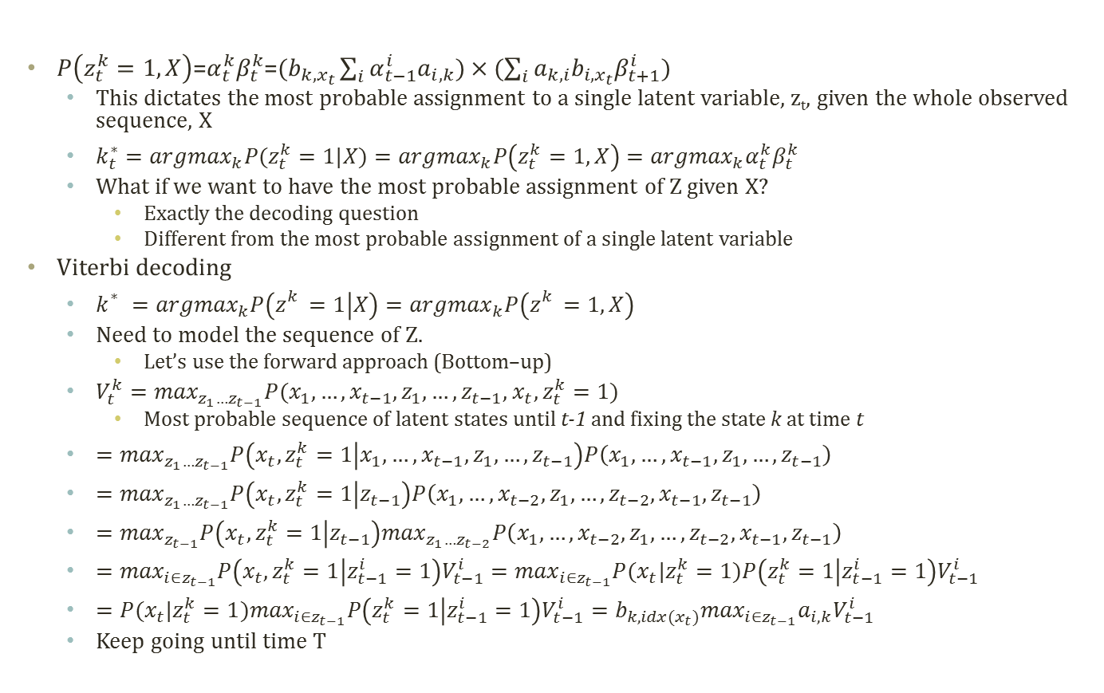




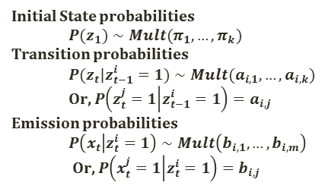
Viterbi Decoding
Initial State probabilities
$$P(z_{1})∼Mult(π_{1},…,π_{k})$$
Transition probabilities
$$P(z_{t}|z_{t−1}^{i}=1)∼Mult(a_{i,1},…,a_{i,k})$$
Or, $P\left(z_{t}^{j}=1 | z_{t−1}^{i}=1\right)=a_{i,j}$
Emission probabilities
$$P\left(x_{t} | z_{t}^{i}=1\right)∼Mult\left(b_{i,1},…,b_{i,m}\right)$$
Or, $P\left(x_{t}^{j}=1 | z_{t}^{i}=1\right)=b_{i,j}$
$P\left(z_{t}^{k}=1,X\right)$=$α_{t}^{k}β_{t}^{k}$=$(b_{k,x_{t}}\sum_{i}{α_{t−1}^{i}a_{i,k}})×(\sum_{i}{a_{k,i}b_{i,x_{t}}β_{t+1}^{i}})$
This dictates the most probable assignment to a single latent variable, z_{t}, given the whole observed sequence, X
$k_{t}^{∗}={argmax}_{k}P(z_{t}^{k}=1|X)={argmax}_{k}P\left(z_{t}^{k}=1,X\right)={argmax}_{k}α_{t}^{k}β_{t}^{k}$
What if we want to have the most probable assignment of Z given X?
Exactly the decoding question
Different from the most probable assignment of a single latent variable
Viterbi decoding
$k_{}^{∗}={argmax}_{k}P\left(z_{}^{k}=1 | X\right)={argmax}_{k}P\left(z_{}^{k}=1,X\right)$
Need to model the sequence of Z.
Let’s use the forward approach (Bottom–up)
$V_{t}^{k}=\max_{z_{1}…z_{t−1}}P(x_{1},…,x_{t−1},z_{1},…,z_{t−1}$, $x_{t},z_{t}^{k}=1)$
Most probable sequence of latent states until t-1 and fixing the state k at time t
$=\max_{z_{1}…z_{t−1}}P\left(x_{t},z_{t}^{k}=1 | x_{1},…,x_{t−1},z_{1},…,z_{t−1}\right)P\left(x_{1},…,x_{t−1},z_{1},…,z_{t−1}\right)$
$=\max_{z_{1}…z_{t−1}}P\left(x_{t},z_{t}^{k}=1 | z_{t−1}\right)P\left(x_{1},…,x_{t−2},z_{1},…,{z_{t−2},x}_{t−1},z_{t−1}\right)$
$=\max_{z_{t−1}}P\left(x_{t},z_{t}^{k}=1 | z_{t−1}\right)\max_{z_{1}…z_{t−2}}P\left(x_{1},…,x_{t−2},z_{1},…,{z_{t−2},x}_{t−1},z_{t−1}\right)$
$=\max_{i∈z_{t−1}}P\left(x_{t},z_{t}^{k}=1 | z_{t−1}^{i}=1\right)V_{t−1}^{i}=\max_{i∈z_{t−1}}P(x_{t}|z_{t}^{k}=1)P\left(z_{t}^{k}=1 | z_{t−1}^{i}=1\right)V_{t−1}^{i}$
$=P(x_{t}|z_{t}^{k}=1)\max_{i∈z_{t−1}}P\left(z_{t}^{k}=1 | z_{t−1}^{i}=1\right)V_{t−1}^{i}=b_{k,idx(x_{t})}\max_{i∈z_{t−1}}a_{i,k}V_{t−1}^{i}$
Keep going until time T

Slide 5
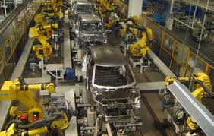
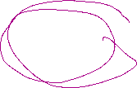
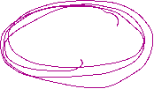
Detour: Assembly Line Scheduling
Assembly Line 1
station S_{1,1}
station S_{1,2}
station S_{1,3}
station S_{1,4}
station S_{1,5}
station S_{1,6}
7
9
3
4
8
4
2
1
3
4
3
2
3
Production Start
Production End
2
1
2
2
1
4
2
8
5
6
4
5
7
station S_{2,1}
station S_{2,2}
station S_{2,3}
station S_{2,4}
station S_{2,5}
station S_{2,6}
Assembly Line 2
Time Cost
Goal: Computing the fastest production route

Slide 6

Detour: Tracing Assembly Line Scheduling in DP
Assembly Line 1
station S_{1,1}
station S_{1,2}
station S_{1,3}
station S_{1,4}
station S_{1,5}
station S_{1,6}
7
9
3
4
8
4
2
1
3
4
3
2
3
Production Start
Production End
2
1
2
2
1
4
2
8
5
6
4
5
7
station S_{2,1}
station S_{2,2}
station S_{2,3}
station S_{2,4}
station S_{2,5}
station S_{2,6}
Assembly Line 2
Used for retrace purpose
Time | 1 | 2 | 3 | 4 | 5 | 6
L1 | 9 | 18 | 20 | 24 | 32 | 35
L2 | 12 | 16 | 22 | 25 | 30 | 37
Trace | 1 | 2 | 3 | 4 | 5 | 6
L1 | S | 1 | 2 | 1 | 1 | 2
L2 | S | 1 | 2 | 1 | 2 | 2

Slide 7
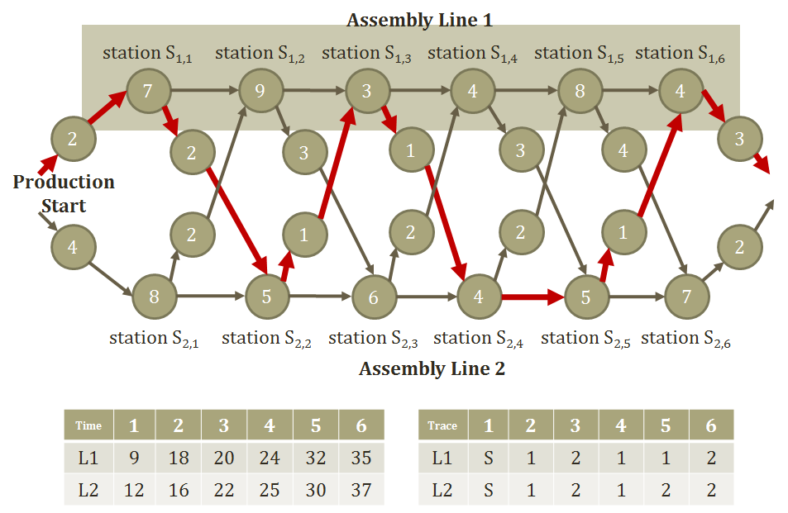







Viterbi Decoding Algorithm
Need to know$V_{t}^{k}$
Time X States
Store $V_{t}^{k}$Two variables to store the trace and the probability up to time t: Two memoization tables
Answering the decoding question with $π$, $a$, $b$, X
ViterbiDecodingAlgorithm
Initialize
$V_{1}^{k}=b_{k,x_{1}}π_{k}$
Iterate until time T
$V_{t}^{k}=b_{k,idx(x_{t})}\max_{i∈z_{t−1}}a_{i,k}V_{t−1}^{i}$
${trace}_{t}^{k}={argmax}_{i∈z_{t−1}}a_{i,k}V_{t−1}^{i}$
Return $P\left(X,Z^{∗}\right)=\max_{k}V_{T}^{k}$, $z_{T}^{∗}={argmax}_{k}V_{T}^{k}$, $z_{t−1}^{∗}={trace}_{t}^{z_{t}^{∗}}$
Technical difficulties in the implemtation
Very frequent underflow problems.
Turn this into the log domain → from multiplication to summation

